Slide 1
MY POWER POINT PRESENTATION
YVAN PRESENTATION

Slide 2
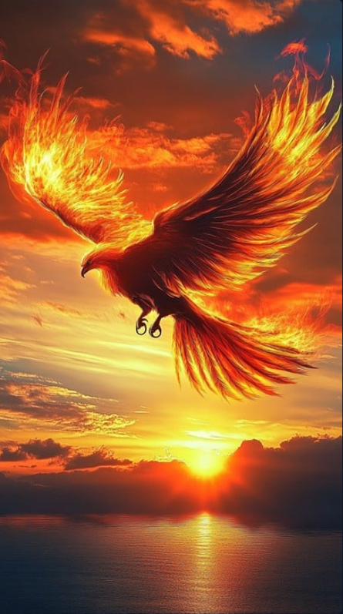
PHOENIX BIRDS

Slide 3
ABOUT PHOENIX BIRDS
Phoenix is a a legendary bird that is known for it’s immortality.
It bursts into ashes and regenerates from it’s ashes into a new one
It’s story is dug up from the ancient Egypt world where it was called Bennu, It was often compared to the sun god Ra where it regenerates everyday as the morning sun.
It’s story was then adapted by the greeks who spread the story world wide, as the bird which lived for centuries .

Slide 4
Symbolism of the bird
1.Rebirth or renew:The Phoenix shows that after destruction or loss, life can begin again.
2.Immortality & Eternal Life:Because it never truly dies, it symbolizes living forever.
3.Strength & Resilience:Rising from ashes represents overcoming difficulties and becoming stronger.
4.Hope:Even in the darkest times, new beginnings are always possible.
5.Transformation:The burning and rebirth symbolize personal growth, change, and spiritual awakening.

Slide 5
Conclusion:
Phoenix bird is a legendary creature that symbolizes rebirth, immortality, and hope. It is believed to burn itself into ashes and rise again, showing that after every end comes a new beginning.
In short, the Phoenix stands for strength, renewal, and eternal life.

